Slide 1
What is the web?
COMP 2511

Slide 2
Internet != Web

Slide 3
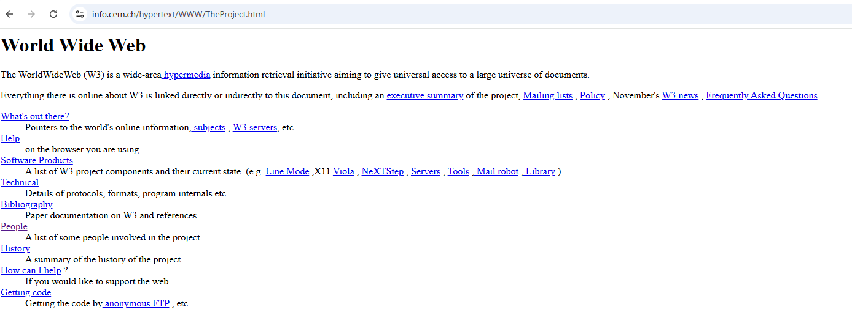
The Very First Website!
https://info.cern.ch/
https://info.cern.ch/hypertext/WWW/TheProject.html

Slide 4
Early Web History?
1991
First Website
1994
W3C
Late 90’s
We used mainly table-based layouts
Early 2000’s
I remember learning Flash
Mid 2000’s
Facebook
2010’s
Responsive and mobile development
Now
Now??
Notes:
1991 – goes live – web is now publicly accessible
1994 – World Wide Web Consortium – founded to set standards

Slide 5
Web Design
Consider the following:

Slide 6
Amazon.com Inc.’s revamped Alexa due for release in October ahead of the U.S. holiday season will be powered primarily by Anthropic’s Claude artificial intelligence models, rather than its own AI, five people familiar with the matter told Reuters. Amazon plans to charge US$5 to US$10 a month for its new “Remarkable” version of Alexa as it will use powerful generative AI to answer complex queries, while still offering the “Classic” voice assistant for free, Reuters reported in June. But initial versions of the new Alexa using in-house software simply struggled for words, sometimes taking six or seven seconds to acknowledge a prompt and reply, one of the people said. That’s why Amazon turned to Claude, an AI chatbot developed by startup Anthropic, as it performed better than the online retail giant’s own AI models, the people said. Reuters based this story upon interviews with five people with direct knowledge of the Alexa strategy. All declined to be named as they are not authorized to discuss non-public matters. Alexa, accessed mainly through Amazon televisions and Echo devices, can set timers, play music, act as a central hub for smart-home controls and answer one-off questions. But Amazon’s attempts to convince users to shop through Alexa to generate more revenue have been mostly unsuccessful and the division remains unprofitable. As a result, senior management has stressed that 2024 is a critical year for Alexa to finally demonstrate it can generate meaningful sales – and the revamped paid version is seen as a way both to do that and keep pace with rivals. “Amazon uses many different technologies to power Alexa,” a company spokeswoman said in a statement in response to detailed Reuters questions for this story.
“When it comes to machine learning models, we start with those built by Amazon, but we have used, and will continue to use, a variety of different models – including [Amazon AI model] Titan and future Amazon models, as well as those from partners – to build the best experience for customers,” the spokeswoman said. Anthropic, in which Amazon owns a minority stake, declined to comment for this story. Amazon has typically eschewed relying on technology it hasn’t developed in-house so it can ensure it has full control of the user experience, data collection and direct relationships with customers. But it would not be alone in turning to a partner to improve AI products. Microsoft Corp. and Apple Inc., for example, have both struck partnerships with OpenAI to use its ChatGPT to power some of their products. The release of the Remarkable Alexa, as it is known internally, is expected in October, with a preview of the new service coming during Amazon’s annual devices and services event typically held in September, the people said. Amazon has not yet said, however, when it plans to hold its showcase event, which will be the first major public appearance of its new devices chief, Panos Panay, who was hired last year to replace long-time executive David Limp.

Slide 7
Amazon.com Inc.’s revamped Alexa due for release in October ahead of the U.S. holiday season will be powered primarily by Anthropic’s Claude artificial intelligence models, rather than its own AI, five people familiar with the matter told Reuters. Amazon plans to charge US$5 to US$10 a month for its new “Remarkable” version of Alexa as it will use powerful generative AI to answer complex queries, while still offering the “Classic” voice assistant for free, Reuters reported in June. But initial versions of the new Alexa using in-house software simply struggled for words, sometimes taking six or seven seconds to acknowledge a prompt and reply, one of the people said. That’s why Amazon turned to Claude, an AI chatbot developed by startup Anthropic, as it performed better than the online retail giant’s own AI models, the people said. Reuters based this story upon interviews with five people with direct knowledge of the Alexa strategy. All declined to be named as they are not authorized to discuss non-public matters. Alexa, accessed mainly through Amazon televisions and Echo devices, can set timers, play music, act as a central hub for smart-home controls and answer one-off questions. But Amazon’s attempts to convince users to shop through Alexa to generate more revenue have been mostly unsuccessful and the division remains unprofitable. As a result, senior management has stressed that 2024 is a critical year for Alexa to finally demonstrate it can generate meaningful sales – and the revamped paid version is seen as a way both to do that and keep pace with rivals. “Amazon uses many different technologies to power Alexa,” a company spokeswoman said in a statement in response to detailed Reuters questions for this story.
“When it comes to machine learning models, we start with those built by Amazon, but we have used, and will continue to use, a variety of different models – including [Amazon AI model] Titan and future Amazon models, as well as those from partners – to build the best experience for customers,” the spokeswoman said. Anthropic, in which Amazon owns a minority stake, declined to comment for this story. Amazon has typically eschewed relying on technology it hasn’t developed in-house so it can ensure it has full control of the user experience, data collection and direct relationships with customers. But it would not be alone in turning to a partner to improve AI products. Microsoft Corp. and Apple Inc., for example, have both struck partnerships with OpenAI to use its ChatGPT to power some of their products. The release of the Remarkable Alexa, as it is known internally, is expected in October, with a preview of the new service coming during Amazon’s annual devices and services event typically held in September, the people said. Amazon has not yet said, however, when it plans to hold its showcase event, which will be the first major public appearance of its new devices chief, Panos Panay, who was hired last year to replace long-time executive David Limp.

Slide 8
Amazon.com Inc.’s revamped Alexa due for release in October ahead of the U.S. holiday season will be powered primarily by Anthropic’s Claude artificial intelligence models, rather than its own AI, five people familiar with the matter told Reuters. Amazon plans to charge US$5 to US$10 a month for its new “Remarkable” version of Alexa as it will use powerful generative AI to answer complex queries, while still offering the “Classic” voice assistant for free, Reuters reported in June. But initial versions of the new Alexa using in-house software simply struggled for words, sometimes taking six or seven seconds to acknowledge a prompt and reply, one of the people said. That’s why Amazon turned to Claude, an AI chatbot developed by startup Anthropic, as it performed better than the online retail giant’s own AI models, the people said. Reuters based this story upon interviews with five people with direct knowledge of the Alexa strategy. All declined to be named as they are not authorized to discuss non-public matters. Alexa, accessed mainly through Amazon televisions and Echo devices, can set timers, play music, act as a central hub for smart-home controls and answer one-off questions. But Amazon’s attempts to convince users to shop through Alexa to generate more revenue have been mostly unsuccessful and the division remains unprofitable. As a result, senior management has stressed that 2024 is a critical year for Alexa to finally demonstrate it can generate meaningful sales – and the revamped paid version is seen as a way both to do that and keep pace with rivals. “Amazon uses many different technologies to power Alexa,” a company spokeswoman said in a statement in response to detailed Reuters questions for this story.
“When it comes to machine learning models, we start with those built by Amazon, but we have used, and will continue to use, a variety of different models – including [Amazon AI model] Titan and future Amazon models, as well as those from partners – to build the best experience for customers,” the spokeswoman said. Anthropic, in which Amazon owns a minority stake, declined to comment for this story. Amazon has typically eschewed relying on technology it hasn’t developed in-house so it can ensure it has full control of the user experience, data collection and direct relationships with customers. But it would not be alone in turning to a partner to improve AI products. Microsoft Corp. and Apple Inc., for example, have both struck partnerships with OpenAI to use its ChatGPT to power some of their products. The release of the Remarkable Alexa, as it is known internally, is expected in October, with a preview of the new service coming during Amazon’s annual devices and services event typically held in September, the people said. Amazon has not yet said, however, when it plans to hold its showcase event, which will be the first major public appearance of its new devices chief, Panos Panay, who was hired last year to replace long-time executive David Limp.

Slide 9
Amazon.com Inc.’s revamped Alexa due for release in October ahead of the U.S. holiday season will be powered primarily by Anthropic’s Claude artificial intelligence models, rather than its own AI, five people familiar with the matter told Reuters.
Amazon plans to charge US$5 to US$10 a month for its new “Remarkable” version of Alexa as it will use powerful generative AI to answer complex queries, while still offering the “Classic” voice assistant for free, Reuters reported in June. But initial versions of the new Alexa using in-house software simply struggled for words, sometimes taking six or seven seconds to acknowledge a prompt and reply, one of the people said.
That’s why Amazon turned to Claude, an AI chatbot developed by startup Anthropic, as it performed better than the online retail giant’s own AI models, the people said.
Reuters based this story upon interviews with five people with direct knowledge of the Alexa strategy. All declined to be named as they are not authorized to discuss non-public matters.
Alexa, accessed mainly through Amazon televisions and Echo devices, can set timers, play music, act as a central hub for smart-home controls and answer one-off questions.
But Amazon’s attempts to convince users to shop through Alexa to generate more revenue have been mostly unsuccessful and the division remains unprofitable. As a result, senior management has stressed that 2024 is a critical year for Alexa to finally demonstrate it can generate meaningful sales – and the revamped paid version is seen as a way both to do that and keep pace with rivals.
“Amazon uses many different technologies to power Alexa,” a company spokeswoman said in a statement in response to detailed Reuters questions for this story.
“When it comes to machine learning models, we start with those built by Amazon, but we have used, and will continue to use, a variety of different models – including [Amazon AI model] Titan and future Amazon models, as well as those from partners – to build the best experience for customers,” the spokeswoman said.

Slide 10
Amazon.com Inc.’s revamped Alexa due for release in October ahead of the U.S. holiday season will be powered primarily by Anthropic’s Claude artificial intelligence models, rather than its own AI, five people familiar with the matter told Reuters.
Amazon plans to charge US$5 to US$10 a month for its new “Remarkable” version of Alexa as it will use powerful generative AI to answer complex queries, while still offering the “Classic” voice assistant for free, Reuters reported in June. But initial versions of the new Alexa using in-house software simply struggled for words, sometimes taking six or seven seconds to acknowledge a prompt and reply, one of the people said.
That’s why Amazon turned to Claude, an AI chatbot developed by startup Anthropic, as it performed better than the online retail giant’s own AI models, the people said.
Reuters based this story upon interviews with five people with direct knowledge of the Alexa strategy. All declined to be named as they are not authorized to discuss non-public matters.
Alexa, accessed mainly through Amazon televisions and Echo devices, can set timers, play music, act as a central hub for smart-home controls and answer one-off questions.
But Amazon’s attempts to convince users to shop through Alexa to generate more revenue have been mostly unsuccessful and the division remains unprofitable. As a result, senior management has stressed that 2024 is a critical year for Alexa to finally demonstrate it can generate meaningful sales – and the revamped paid version is seen as a way both to do that and keep pace with rivals.
“Amazon uses many different technologies to power Alexa,” a company spokeswoman said in a statement in response to detailed Reuters questions for this story.
“When it comes to machine learning models, we start with those built by Amazon, but we have used, and will continue to use, a variety of different models – including [Amazon AI model] Titan and future Amazon models, as well as those from partners – to build the best experience for customers,” the spokeswoman said.

Slide 11
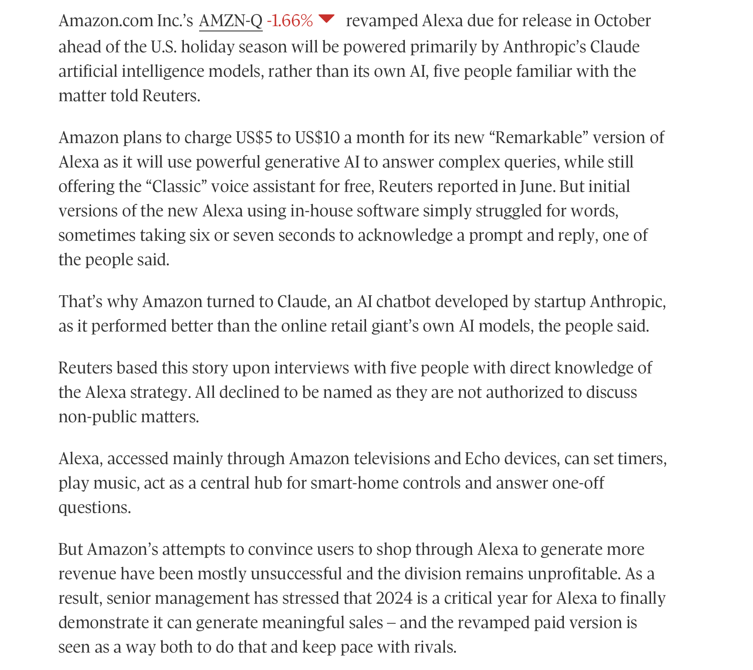

Slide 12
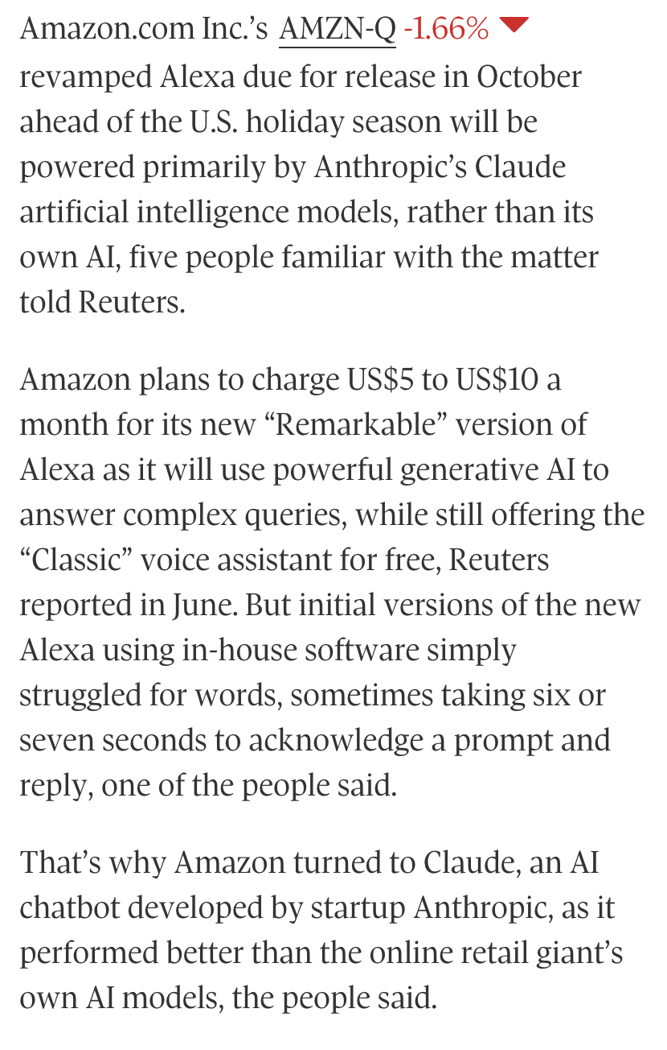
Notes:
Web design – not just looks. Discuss HCI class – usability, UX, accessibility, visual,

Slide 13
“Good design is actually a lot harder to notice than poor design, in part because good designs fit our needs so well that the design is invisible, serving us without drawing attention to itself. Bad design, on the other hand, screams out its inadequacies, making itself very noticeable.” -- Don Norman, The Design of Everyday THings

Slide 14
“Good design is actually a lot harder to notice than poor design, in part because good designs fit our needs so well that the design is invisible, serving us without drawing attention to itself. Bad design, on the other hand, screams out its inadequacies, making itself very noticeable.” -- Don Norman, The Design of Everyday Things

Slide 15
Bad Design Affects Us
Money
A $200 withdrawal turns into $20000
Bad font choice ➔ “,” looks like “.”

Slide 16
Bad Design Affects Us
Anticipated snarky response: “But, I wouldn’t make those mistakes!”
Maybe, but you’re not the only one working on most projects. Your team might still make that mistake.
Here’s the problem:
You are typically not the user.
You have your own biases.

Slide 17
What is this course about?
Understanding basic design principles
Learning and practicing methods for “good” design
Experience sketching & prototyping
Implement designs into HTML & CSS

Slide 18
Software and Book
Visual Studio Code and Notepad
Textbook:
Fundamentals of Web Development (3rd Edition)
Connolly and Hoar. Pearson, 2022
Earlier additions are welcome.

Slide 19
My Expectations of You
Arrive timely (and quietly)
Ask questions in class, lab, and via email
Respect

Slide 20
What You Can Expect of Me
Assignments within 1-2 weeks
Emails replies will come within 1-2 business days
If I don't know the answer to your question, we will find out together
I will treat you as professional colleagues

Slide 21
Summary
Design is everywhere
Good design is hard
Poorly designed things have consequences
Good design practices can help

Slide 22
References
Galitz, W.O. (2007). The Essential Guide to User Interface Design: An Introduction to GUI Design Principles and Techniques (3rd ed.). John Wiley & Sons, Inc. ISBN: 9780470053423.
http://en.wikipedia.org/wiki/User_interface
Jim Davis, with acknowledgements to Namrata Khemka-Dolan

